Slide 1
Vue Router

Slide 2
Basis for Single Page Applications
Prevent repeated calls to the server for HTML
Load all the components you need
Change components out based off browser state (URLs)
<App>
</App>

Slide 3
How does a VueJS SPA work?
<App>
</App>
<Slot />
https://myDomain/routeA
<Slot />
https://myDomain/routeB

Slide 4
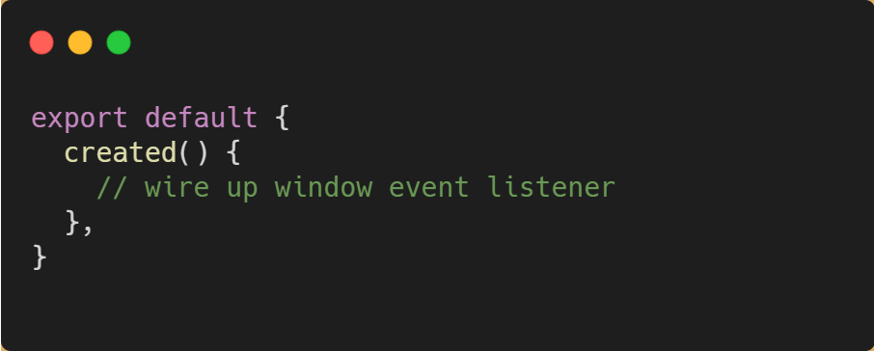
You could build this yourself…

Slide 5
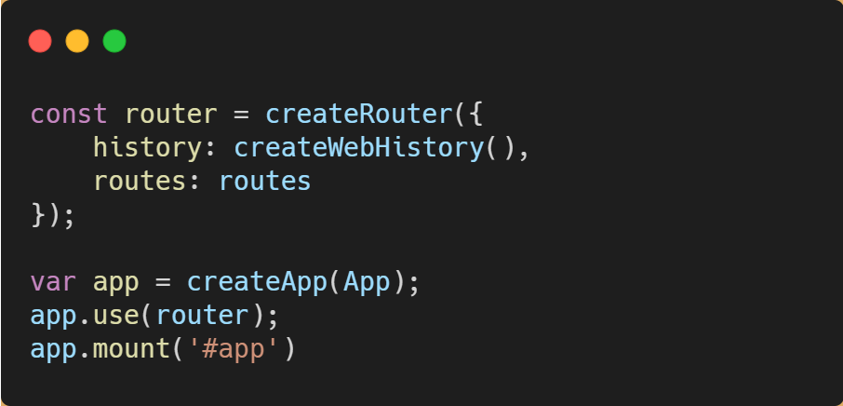
… or use Vue Router

Slide 6
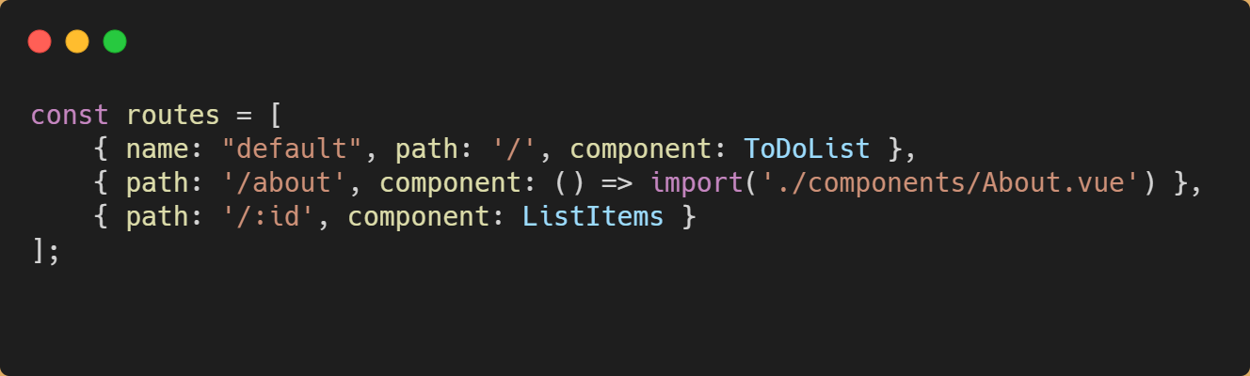
Routes
A route has 3 primary properties:
Name: a friendly name for any route
Path: the URL path (what you see in the address bar)
Component: which Vue component should be loaded

Slide 7
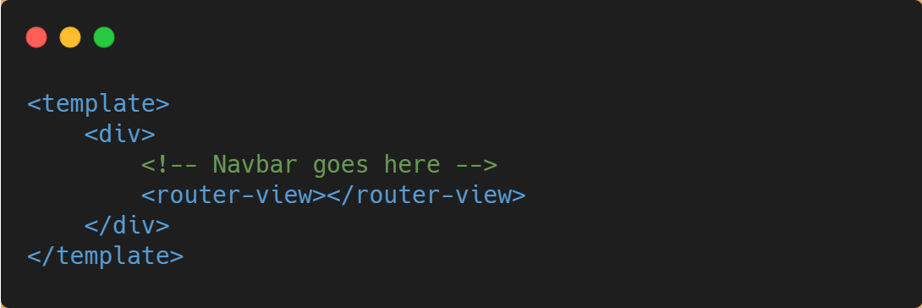
<router-view>

Slide 8
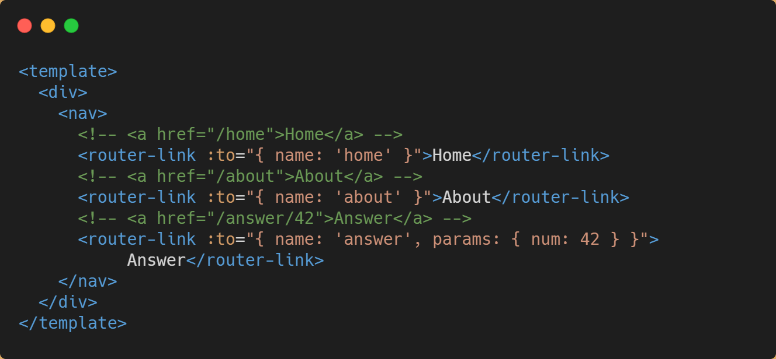
<router-link>

Slide 9
Demo
Implementing a Vue Router

Slide 10
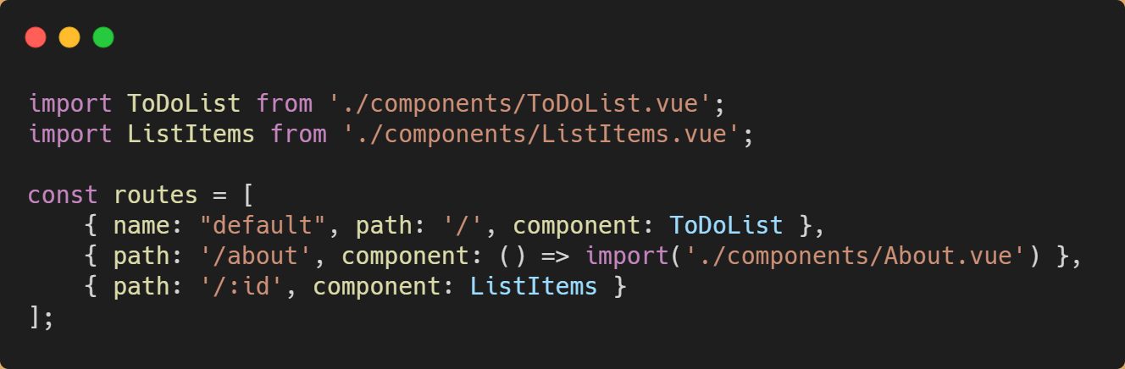
Eager Loading vs Lazy Loading

Slide 11
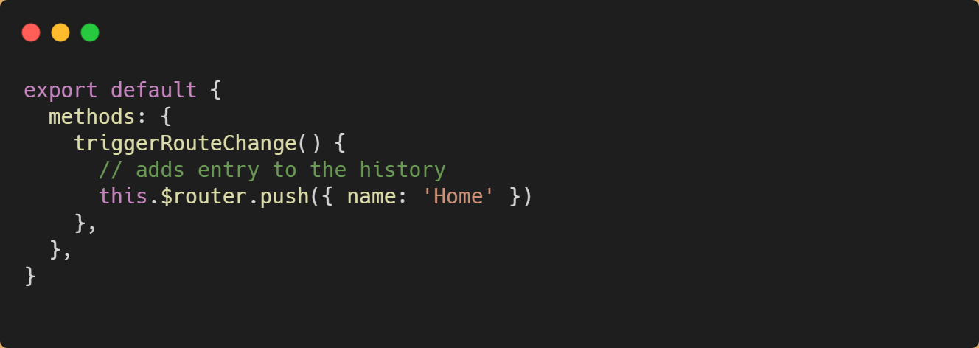
Change Route Programmically

Slide 12
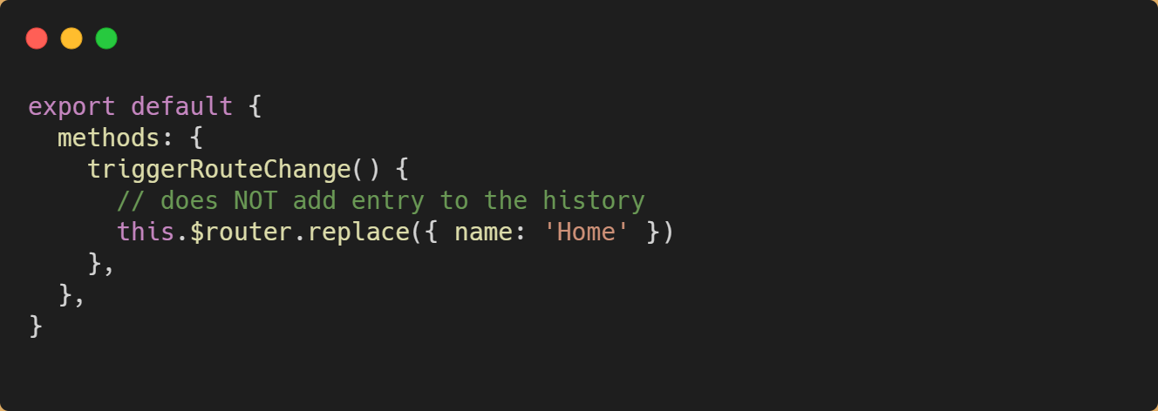
Change Route Programmically

Slide 13
Hands On Lab: Vue Router
If you haven’t already, pull the latest GitHub repo for this workshop
Go to the “/exercises/3_Vue Router” folder and open the README.md.
Length: 25 minutes

